Slide 1
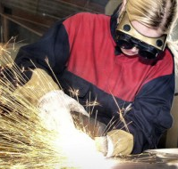

Slide 2
About the Program
The Career and Technical Education (CTE) College Credit Program awards free college credit for approved high school CTE programs. The approved CTE programs are a sequence of high school elective classes, taught by your teachers, in your own high school.
Earning free college credit saves you time and money by helping you complete your college degree, certificate, or industry credential more quickly, because you are not repeating coursework you already mastered in high school!

Slide 3
What is a CTE Program?
A CTE program is a sequence of high school elective classes, taught by the teachers, in each high school.
Example:
Program | Course Sequence | Possible Degree
Culinary Arts | Culinary Arts I Culinary Arts II Culinary Arts III | Certificate of Achievement-Culinary Arts Associate of Applied Science Degree-Culinary Arts

Slide 4
Requirements
Apply to Truckee Meadows Community College
Complete the CTE program course sequence with a B average or higher.
Students do not have to obtain a B in every course. They just need to have a 3.0 GPA average for the entire program.

Slide 5
Requirements Continued.
Students need to pass the State End-of-Program Technical Skills Assessment.
The score varies from course to course.
Score range 50-80%
Pass the State Workplace Readiness Skills Assessment
Every program is required to take this exam once
Passing score is a 75%

Slide 7
AACT
CTE Program | Course Sequence | Possible Credits
Baking and Pastry | Culinary Arts I Baking and Pastry I Baking and Pastry II | 8
Culinary Arts | Culinary Arts I Culinary Arts II Culinary Arts III | 14
Drafting and Design | Drafting and Design I Drafting and Design II Drafting and Design III | 9
Emergency Medical Technician | Health Science I Health Science II or Emergency Medical Services Emergency Medical Technician | 10
Graphic Design | Graphic Design I Graphic Design II Graphic Design III | 11
Video Production | Video Production I Video Production II Video Production III | 7
Veterinary Science | Agriculture Science I Agriculture Science II Veterinary Science | 3
Welding Technology | Welding Technology I Welding Technology II Welding Technology III | 20

Slide 8
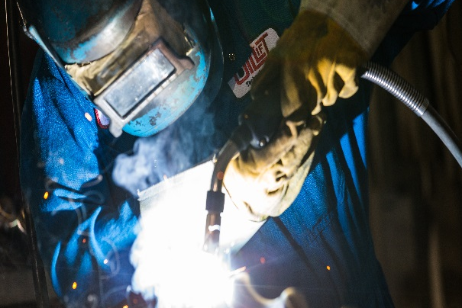
ACE
CTE Program | Course Sequence | Possible Credits
Construction Technology | Construction Technology I Construction Technology II Construction Technology III | 13
Drafting and Design | Drafting and Design I Drafting and Design II Drafting and Design III | 9

Slide 9
Damonte Ranch High School
CTE Program | Course Sequence | Possible Credits
Computer Science | Computer Science I Computer Science II Computer Science III or AP Computer Science A | 9
Foods and Nutrition | Foods and Nutrition I Foods and Nutrition II Foods and Nutrition III | 9
Theatre Technology | Theatre Technology I Theatre Technology II Theatre Technology III | 6
Video Production | Video Production I Video Production II Video Production III | 7
Web Design and Development | Web Design and Development I Web Design and Development II Web Design and Development III | 6

Slide 10
Galena High School
CTE Program | Course Sequence | Possible Credits
Construction Technology | Construction Technology I Construction Technology II Construction Technology III | 7
Culinary Arts | Culinary Arts I Culinary Arts II Culinary Arts III | 14
Drafting and Design | Drafting and Design I Drafting and Design II Drafting and Design III | 9
Metalworking | Metalworking I Metalworking II Metalworking III | 18
Web Design and Development | Web Design and Development I Web Design and Development II Web Design and Development III | 6

Slide 11
Hug High School
CTE Program | Course Sequence | Possible Credits
Baking and Pastry | Culinary Arts I Baking and Pastry I Baking and Pastry II | 8
Culinary Arts | Culinary Arts I Culinary Arts II Culinary Arts III | 14
Human Development | Human Development I Human Development II Human Development III | 6
Web Design and Development | Web Design and Development I Web Design and Development II Web Design and Development III | 6

Slide 12
Incline High School
CTE Program | Course Sequence | Possible Credits
Automotive Technology | Automotive Technology I Automotive Technology II Automotive Technology III | 13
Drafting and Design | Drafting and Design I Drafting and Design II Drafting and Design III | 9
Foods and Nutrition | Foods and Nutrition I Foods and Nutrition II Foods and Nutrition III | 9
Welding Technology | Welding Technology I Welding Technology II Welding Technology III | 20

Slide 13
McQueen High School
CTE Program | Course Sequence | Possible Credits
Automotive Technology | Automotive Technology I Automotive Technology II Automotive Technology III | 13
Baking and Pastry | Culinary Arts I Baking and Pastry I Baking and Pastry II | 8
Culinary Arts | Culinary Arts I Culinary Arts II Culinary Arts III | 14
Human Development | Human Development I Human Development II Human Development III | 6
Metalworking | Metalworking I Metalworking II Metalworking III | 18

Slide 14
North Valleys High School
CTE Program | Course Sequence | Possible Credits
Animation | Animation I Animation II Animation III | 9
Culinary Arts | Culinary Arts I Culinary Arts II Culinary Arts III | 14
Diesel Technology | Diesel Technology I Diesel Technology II Diesel Technology III | 8
Drafting and Design | Drafting and Design I Drafting and Design II Drafting and Design III | 9
Graphic Design | Graphic Design I Graphic Design II Graphic Design III | 11
IT Service and Support | IT Essentials I IT Essentials II | 10
Web Design and Development | Web Design and Development I Web Design and Development II Web Design and Development III | 6

Slide 15
Reed High School
CTE Program | Course Sequence | Possible Credits
Automotive Technology | Automotive Technology I Automotive Technology II Automotive Technology III | 13
Biomedical | Biomedical I Biomedical II Biomedical III | 9
Drafting and Design | Drafting and Design I Drafting and Design II Drafting and Design III | 9
Energy Technologies | Energy Technologies I Energy Technologies II Energy Technologies III | 16
Foods and Nutrition | Foods and Nutrition I Foods and Nutrition II Foods and Nutrition III | 9
Graphic Design | Graphic Design I Graphic Design II Graphic Design III | 11
Human Development | Human Development I Human Development II Human Development III | 6
Metalworking | Metalworking I Metalworking II Metalworking III | 18

Slide 16
Reno High School
CTE Program | Course Sequence | Possible Credits
Animation | Animation I Animation II Animation III | 9
Graphic Design | Graphic Design I Graphic Design II Graphic Design III | 11
Video Production | Video Production I Video Production II Video Production III | 7
Web Design and Development | Web Design and Development I Web Design and Development II Web Design and Development III | 6

Slide 17
Sparks High School
CTE Program | Course Sequence | Possible Credits
Animation | Animation I Animation II Animation III | 9
Drafting and Design | Drafting and Design I Drafting and Design II Drafting and Design III | 9
IT Service and Support | IT Essentials I IT Essentials II | 10
Manufacturing Technologies | Manufacturing Technologies I Manufacturing Technologies II Manufacturing Technologies III | 18
Metalworking | Metalworking I Metalworking II Metalworking III | 18
Web Design and Development | Web Design and Development I Web Design and Development II Web Design and Development III | 6

Slide 18
Spanish Springs High School
CTE Program | Course Sequence | Possible Credits
Animation | Animation I Animation II Animation III | 9
Automotive Technology | Automotive Technology I Automotive Technology II Automotive Technology III | 13
Baking and Pastry | Culinary Arts I Baking and Pastry I Baking and Pastry II | 8
Computer Science | Computer Science I Computer Science II Computer Science III or AP Computer Science A | 9
Culinary Arts | Culinary Arts I Culinary Arts II Culinary Arts III | 14
Early Childhood Education | Early Childhood Education I Early Childhood Education II Early Childhood Education III | 6
Graphic Design | Graphic Design I Graphic Design II Graphic Design III | 11
IT Service and Support | IT Essentials I IT Essentials II | 10
Video Production | Video Production I Video Production II Video Production III | 7
Web Design and Development | Web Design and Development I Web Design and Development II Web Design and Development III | 6

Slide 19
Wooster High School
CTE Program | Course Sequence | Possible Credits
Energy Technologies | Energy Technologies I Energy Technologies II Energy Technologies III | 16
Human Development | Human Development I Human Development II Human Development III | 6
Web Design and Development | Web Design and Development I Web Design and Development II Web Design and Development III | 6

