Slide 1
Preparing for High School
And your future!

Slide 2
What do I need to go onto High School?

Slide 3
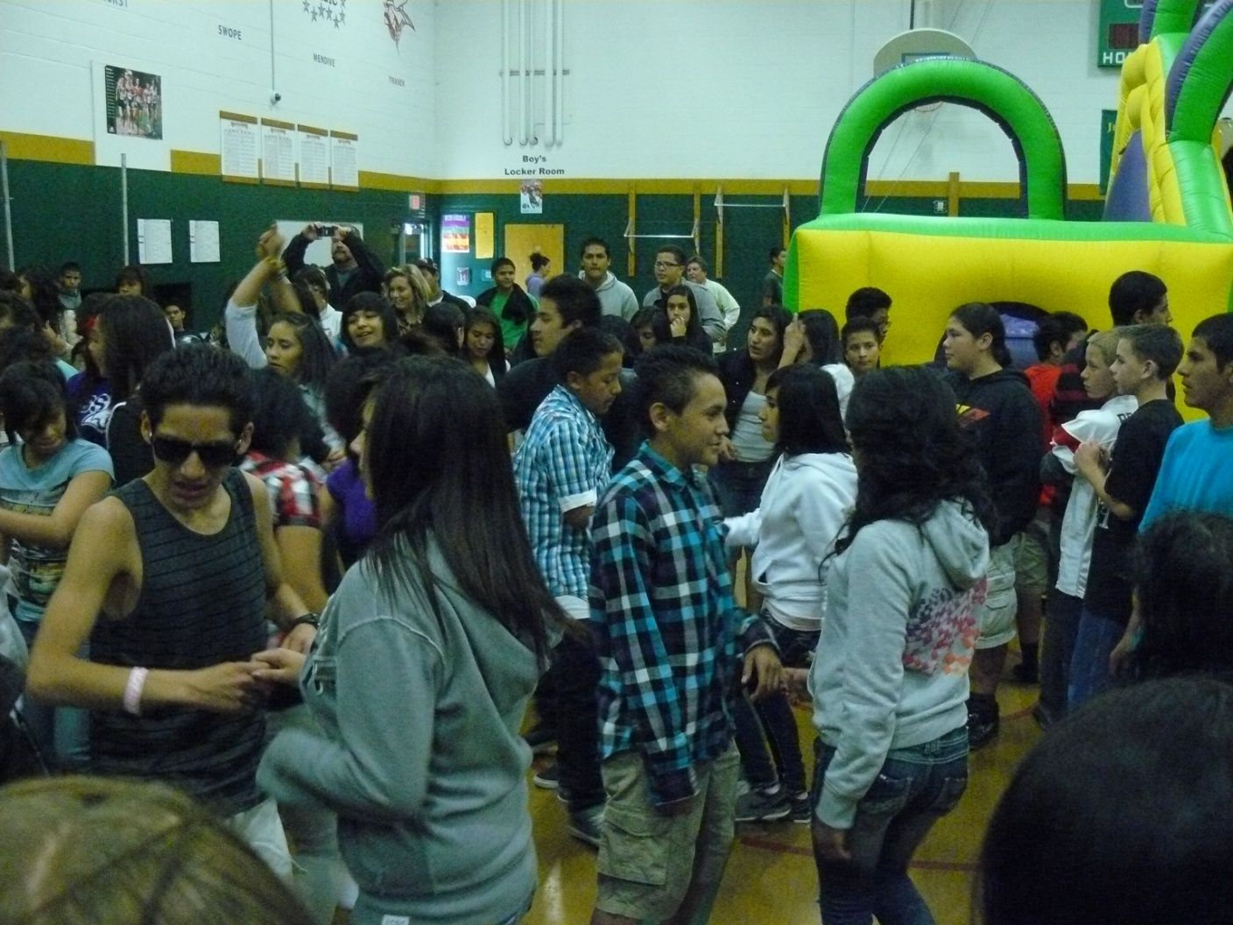
To move onto high school….
Earn your middle school credits in English, Math, Science, and Social Studies
Good attendance

Slide 4
High School Credits
22 ½ Credits
3 Math
4 English
2 Science
3 History
2 PE / ROTC
.5 Health
.5 Computers

Slide 5
90 % Attendance
No more than 9 days absent per semester

Slide 6
High School Diploma
Standard – 22.5 credits + pass end of course exams
Advanced- 24 credits + 3.25 or above GPA+ pass end of course exams
Honors – 24 credits (8 in honors level classes) + 3.4 or above GPA + pass end of course exams
Everyone must take the ACT

Slide 7
Your GPA – grade point average
CLASS RANK
COLLEGE
Calculating GPA:
A = 4
B = 3
C = 2
D = 1
F = 0
Examples…….

Slide 8
What are your options for high school?
Zoned school
Variance

Slide 9
Other high school options:

Slide 10
Signature Academies
Each high school
Career experience
No transportation (ONLY FOR WOOSTER AND AACT)

Slide 11
Signature Academies:
Performing Arts Academy at Damonte Ranch HS
Health Occupation /Culinary/ Engineering at Reed HS
Media Arts and Communication / Sports Medicine Academy at Spanish Springs HS
IT/ Computer programming/Drones – Sparks HS
Medical/ Culinary – Hug HS

Slide 12
International Baccalaureate - IB Program at Wooster HS
IB exams for college credits
Transportation available
Rigorous/Challenging

Slide 13
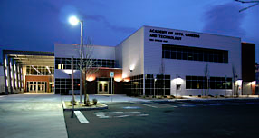
AACT – The Academy HS https://www.youtube.com/watch?v=_E7TwoIYQdY&index=1&list=PL6_loJgn25NQrj2jAecav8YfnkStR-OzU
Community college credit
Transportation available
No music or sports
7 Academies
Communication Arts & Media Academy
Culinary & Hospitality Academy
Education & Training Academy
Engineering Academy
HS of Business Academy
Medical Academy
Natural Resource & Animal Science

Slide 14
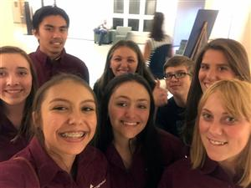
TMCC High School
HIGH SCHOOL/COLLEGE CREDITS https://vimeo.com/151403978
Sophomore year of High School
FREE College Tuition
Access to College resources, labs, learning centers, tutors, gym, etc.
Receive instruction from college instructors
Rigorous/Challenging

Slide 15
1st generation- SHS/HUG
FREE College Preparatory Services
Offer fully paid college tours of Universities outside the area
Academic Summer program
https://www.youtube.com/watch?v=wUI0TWnwFh8

Slide 16
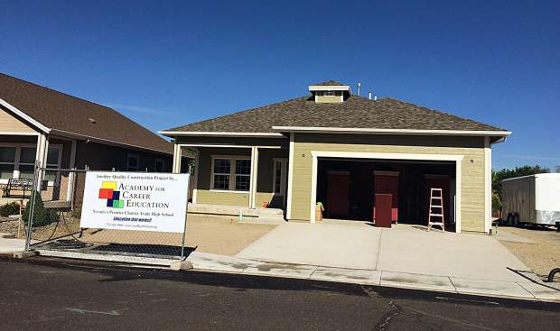
ACE Charter School
Construction Trades, Diesel Mechanics, and Architectural/technical drafting/design
Hands on, applied learning environment
https://www.youtube.com/watch?v=XZy8TTmEv70

Slide 17
Sageridge School
SMS students CAN compete!

Slide 18
Question
Why is education and other specialized training important for your future?

Slide 19
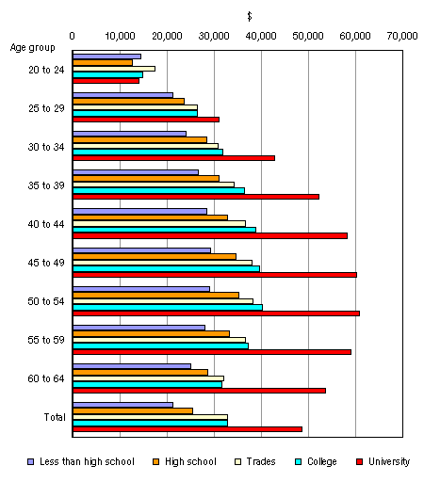

Slide 20
Ways to Pay for College
Scholarships: Academics, Sports, Music etc.
Millennium Scholarship – 3.25 + pass end of course exams
Loans, work study
Grants

Slide 21
Questions????

